Slide 1
Classification
Giovanni Filomeno,
Katharina Hehenwarter,
Elīna Emīlija Ungure,
Kathrin Hofmarcher
Machine Learning and Pattern Classification

Slide 2


Labeling Functions Accuracy
Goal: Evaluate how well our rule-based labeling functions identify acoustic events from audio data, balancing precision and recall.
Overall Performances:
Macro-F1: 0.451
Micro-F1: 0.443
Precision: 0.466
Recall: 0.421
Classes with good performances:
Violin (F1 $≈$ 0.72)
Saxophone (F1 $≈$ 0.72)
Piano (F1 $≈$ 0.66)
Vacuum Cleaner (F1 $≈$ 0.57)
Problematic classes
Broadband noise (waves, fire) $\sim$ 800 False Positives
Short events (bicycle squeak, sneeze) low recall due to strict thresholds (duration/energy)

Slide 3
Most Discriminative Audio Features
Goal: Identify audio features (MFCCs, zero-crossing rate) that best distinguish event classes.
Mutual Information Analysis:
Strongly discriminative features identified: Airplane: MFCC-1 and zero-crossing rate Rain: MFCC-0 and MFCC-5
Problematic classes show a flat MI profile, meaning no single distinctive feature
Low-order MFCCs and zero-crossing rate strongly distinguish harmonic/stationary sounds.
Current features insufficient for impulsive or spectrally overlapping events

Slide 4
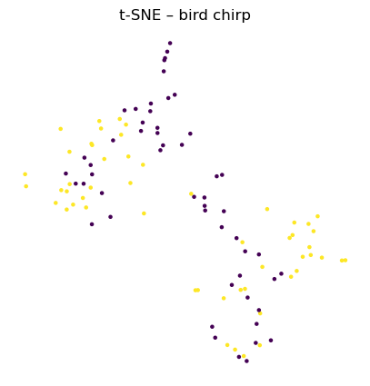
Clustering of Audio Features
Goal: Assess whether audio features naturally group into tight clusters corresponding to event classes
Quantitative Clustering Evaluation:
Silhouette Score: very low (max 0.008 for cow moo, sewing machine)
Davies-Boulding Index: very high (10-14, e.g., saxophone = 14)
Considerations:
Very weak clusters, strong overlap among classes
Features lack separability, implying difficulties for simple linear classifier
t-SNE embedding of MFCC and zero-crossing rate features for class "bird chirp". Yellow points are positive examples; purple points are negative examples.

